Slide 1
SCExAO Polarization Modeling & Polarimetry
Jaren Ashcraft
Ph.D. Candidate in Optical Sciences
NASA Space Technology Graduate Research Fellow
University of Arizona

Slide 2
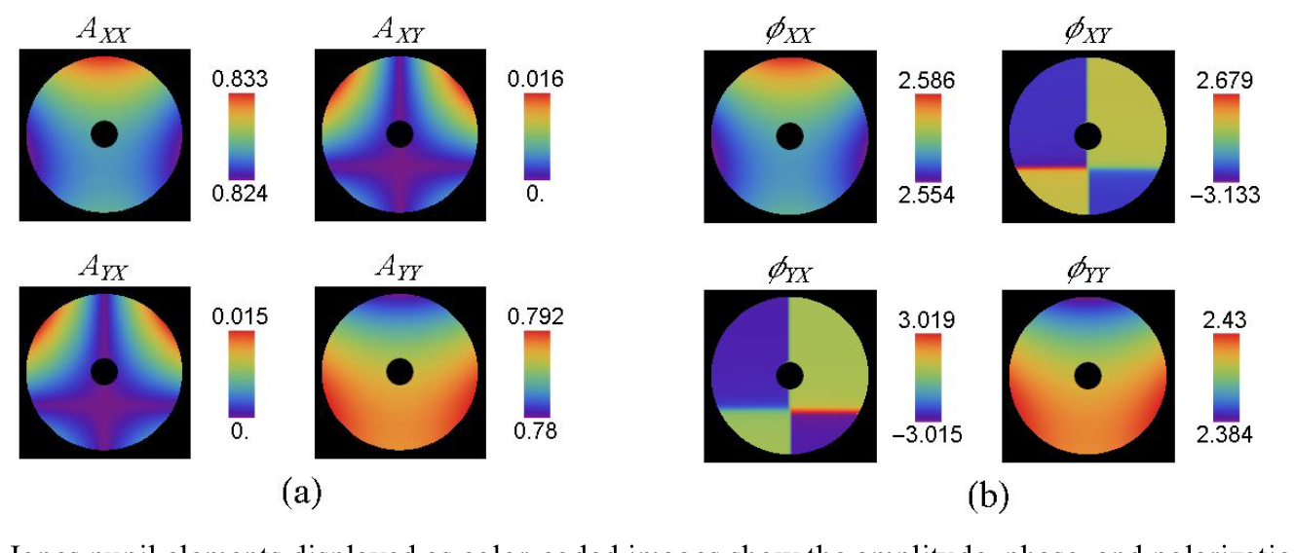
Motivation
Polarization is a limiter to high-contrast imaging & polarimetric instrumentation
Amplitude (a) and Phase (b) aberrations are induced by optical surfaces
I’d like to use this information to design coronagraphs that are robust to polarization aberrations for my PhD!
Jones Pupil of an astronomical telescope revealing polarization aberrations.
Source: Cassegrain Telescope with a Fold Mirror, Airy Optics

Slide 3
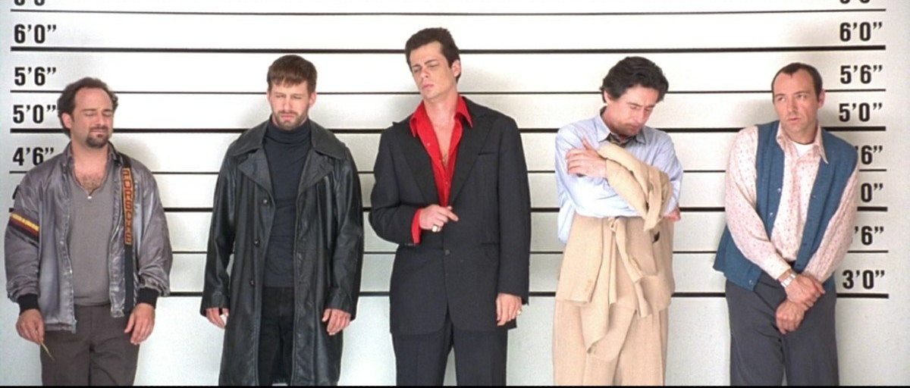
Common Polarization Aberration Sources
Optical Coatings
Diffraction Gratings
Anisotropic Optics
Fold Mirrors
Observatory Mirrors
Source: The Usual Suspects

Slide 4
Project Goals
Polarimetry: Characterize instrumental polarization aberration in SCExAO with a Pupil Imager
Measure the polarization effects across the exit pupil
Polarization Ray Tracing: Develop model of instrumental polarization in SCExAO
Assess contributions from optical components

Slide 5
Polarimetry for SCExAO
Develop pupil-imaging polarimeter for SCExAO
Assess available polarization optics
Implement polarimeter hardware (if necessary)
Measure instrumental polarization in SCExAO
Where can we measure the pupil of the telescope?

Slide 6
Thoughts on Polarization Measurement
Goal is to measure a Mueller Matrix for SCExAO so we can understand how the polarization state is transformed
These data can be compared to a polarization ray trace model produced by the SCExAO raytrace
What is Necessary to Accomplish This?
2 polarizers
2 quarter-wave plates
A pupil image on a detector after the system you want to measure
The biggest problem right now seems to be just fitting this instrument somewhere

Slide 7
Basic Polarimetry
POL
QWP
Your
Optical System Goes Here
QWP
POL
SENSOR

Slide 8
Basic Polarimetry
POL
QWP
Your
Optical System Goes Here
QWP
POL
SENSOR
Fixed
Rotates
Rotates
Rotates

Slide 9
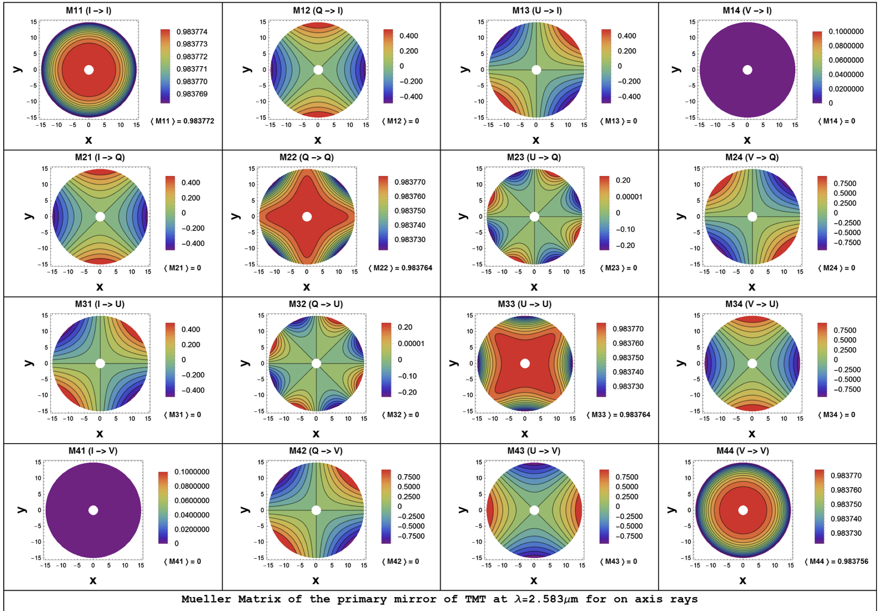
TMT Primary Mirror Mueller Matrix
Anticipate measurements that look like this “Mueller Pupil”
Credit to Dr. Ramya Anche
Analysis of polarization introduced due to the telescope optics of the Thirty Meter Telescope, JATIS (2018)

Slide 10
Where Should we put the Polarimeter?
At science image plane
Eliminate most NCPA’s
Can do PDI on the pupil
Likely challenging to implement w/ space constraints
At an earlier available pupil-viewing camera
The difference in path won’t contribute that much to polarization aberrations
Should be after any fold mirrors if possible
A self-contained instrument
Can place anywhere in the path an generate the pupil, just need to drop into the path.

Slide 11
Open Source Polarimetry
Characterizing instrumental polarization will be critical for any large telescope
Publishing the methods / code developed can help ELT’s with Polarimetry
https://github.com/Jashcraf/Observatory-Polarimetry
Can presently do full stokes polarimetric data reduction

Slide 12
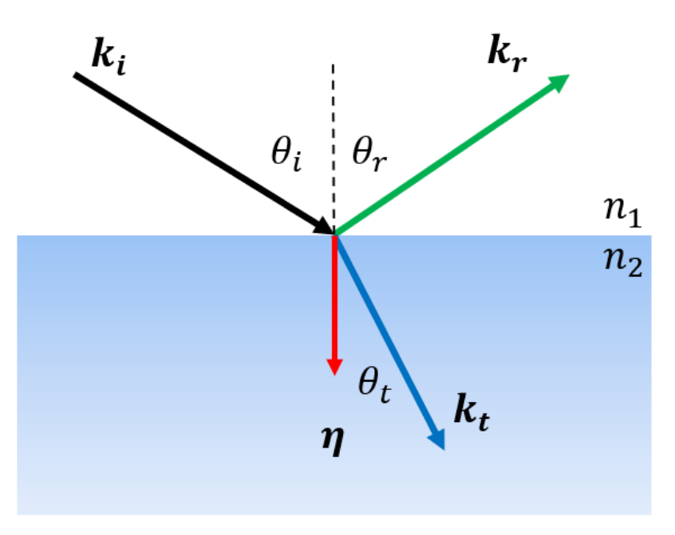
Polarization Ray Tracing
A generalization of the interface problem
Links vector field behavior to ray tracing
Essentially jones calculus in 3 dimensions through ray traces of optical systems

Slide 13
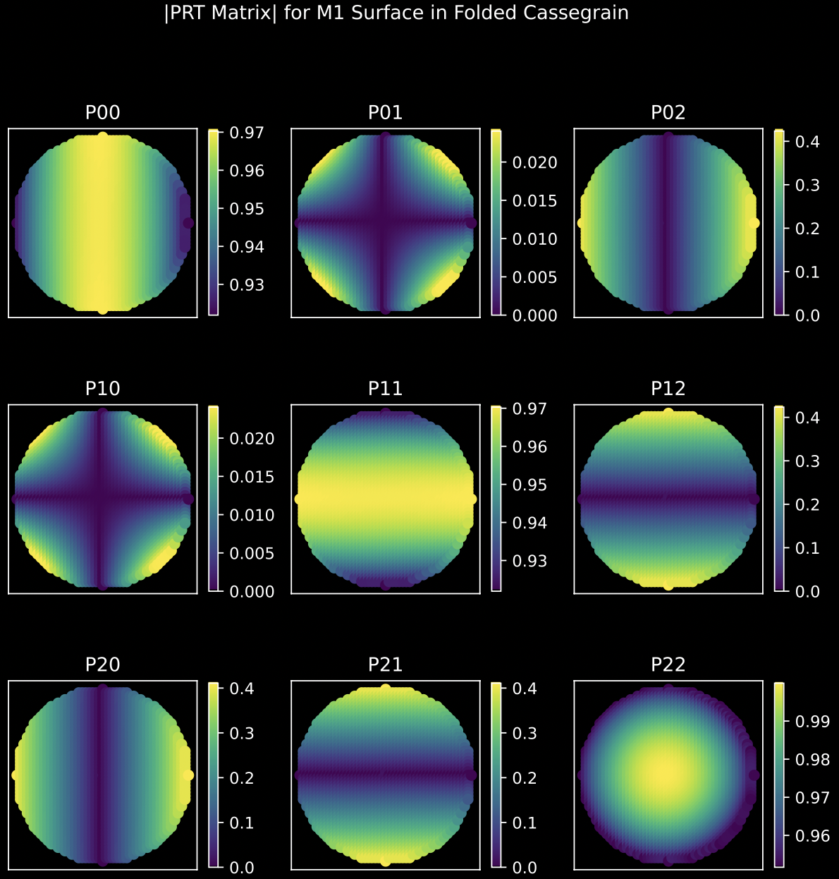
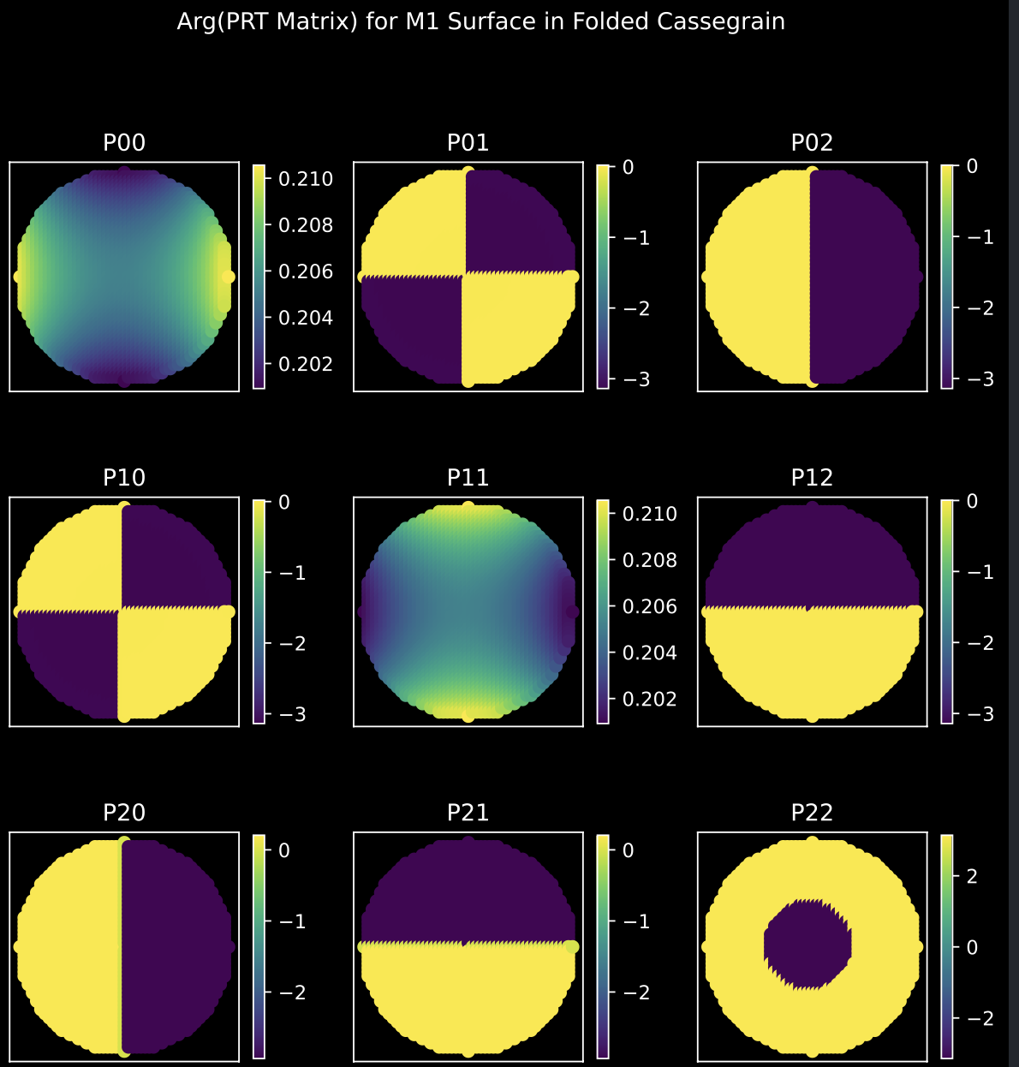
Preliminary Results
Maltese Cross PSF
Looks like on-axis astigmatism

Slide 14
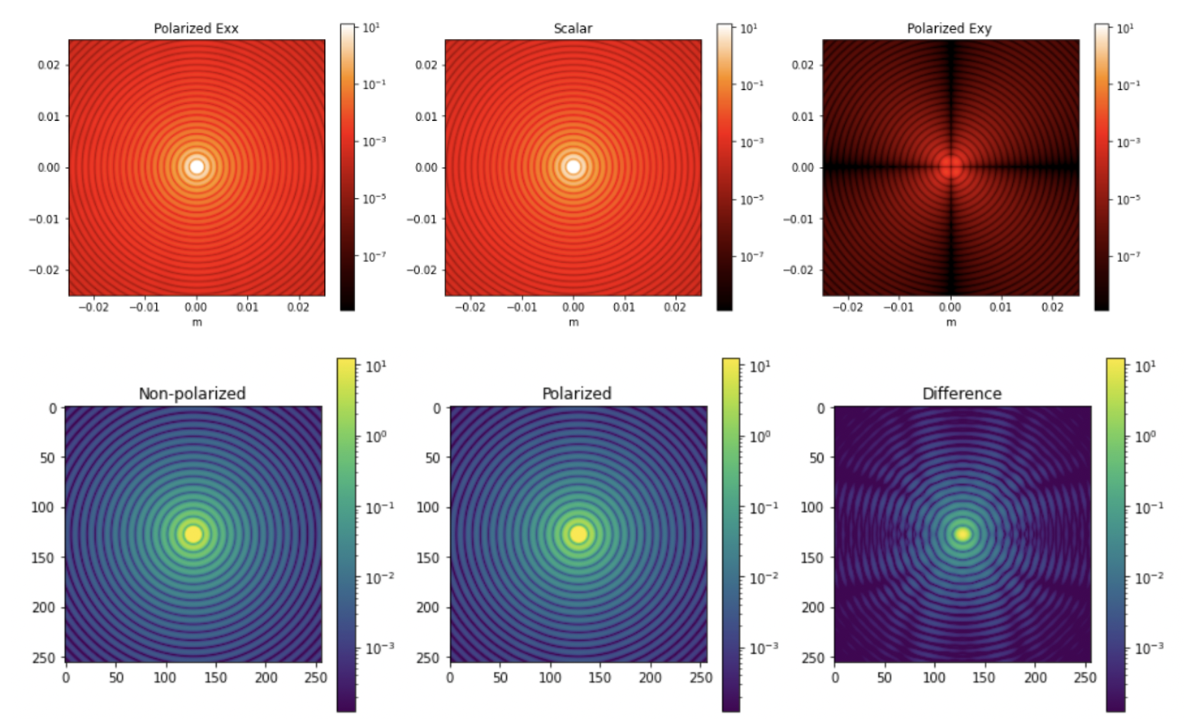
The Resultant PSF
With a linear polarizer oriented in the x-direction, both components would pass

Slide 15
Open Source PRT
Development of a PRT model for Subaru & SCExAO will be ongoing through the summer
Currently using Python and the Zemax API to run a ray trace and generate PRT matrices for optics
https://github.com/Jashcraf/Polarization-Raytrace
Can presently construct the PRT matrix of a single surface in a Zemax optical system

Slide 16
06/16/2022

Slide 17
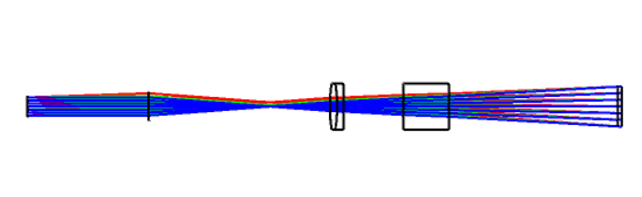
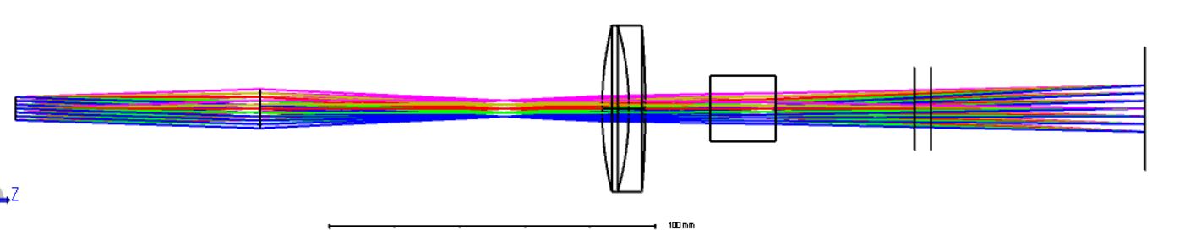
Pupils don’t have to be in collimated spaces
Current Design
Drop negative lens
Translate positive lens 100mm
Insert f = 75mm lens after pupil
Miles’ Future Design
Insert f = 75mm lens after pupil
(It’s easier)

Slide 18
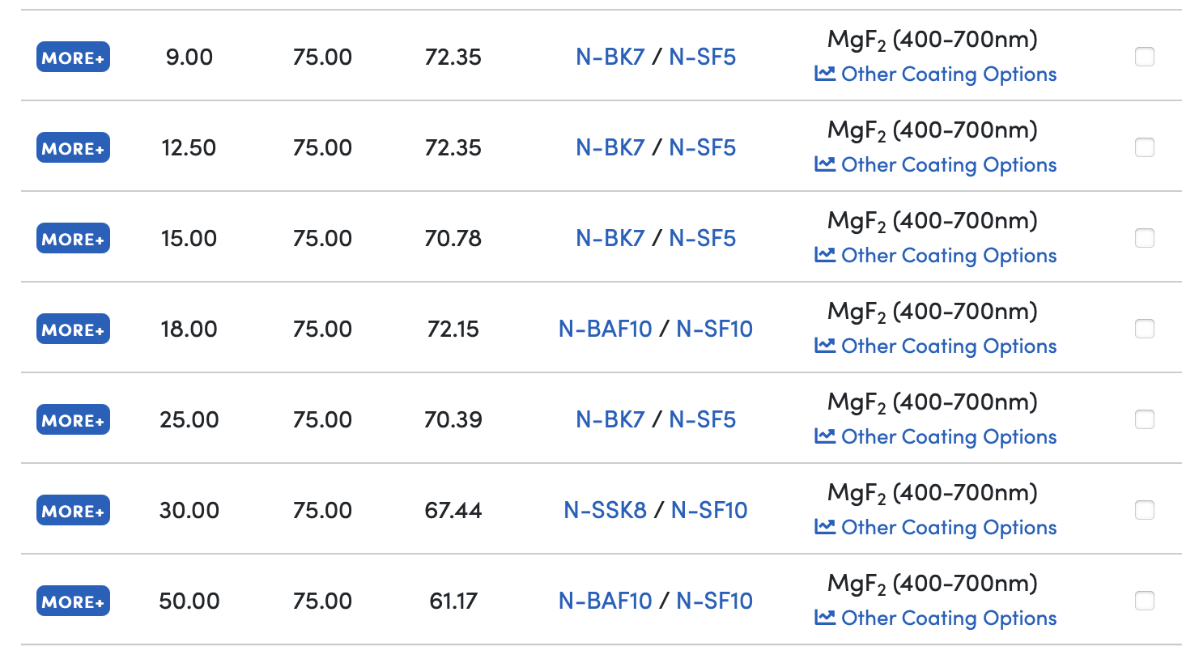
Are there f = 75mm lenses available?
Yep! We have our choice of achromats and aspheres too

Slide 19
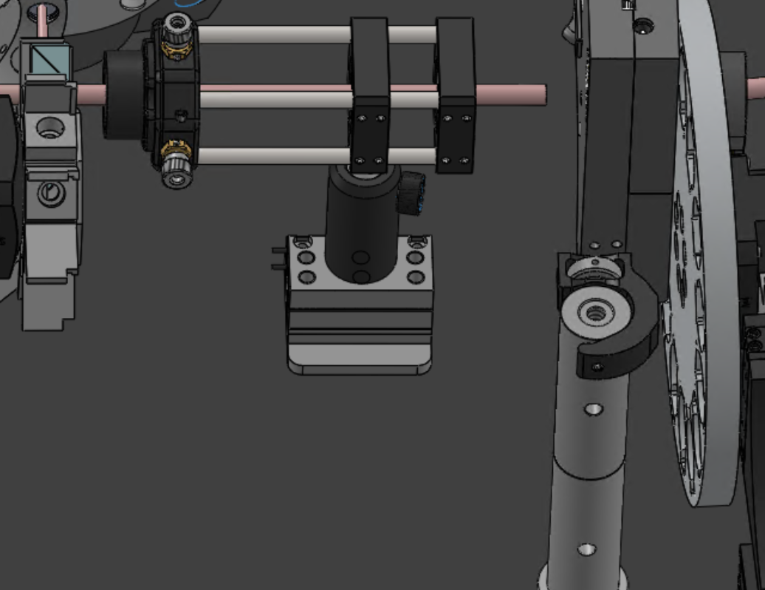
This Plan Sounds Hard
Current Design
Drop negative lens
Translate positive lens 100mm
Insert f = 75mm lens after pupil
Would it be easier to just translate in a new set of lenses, and translate out the telephoto lens?
Move Entire Group Out of Path

Slide 20
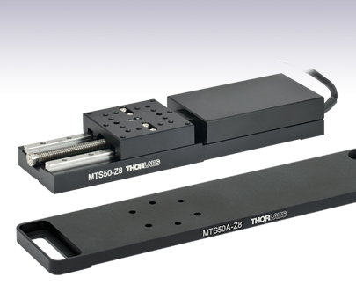
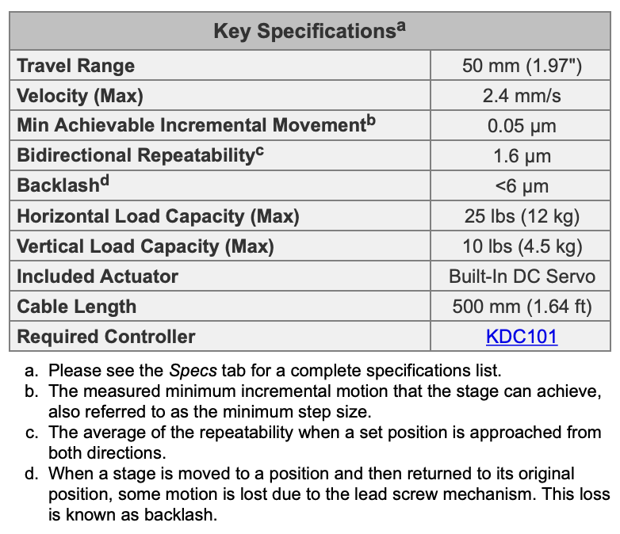
THORLABS 2” Translation Stage
Price: $1800

Slide 21
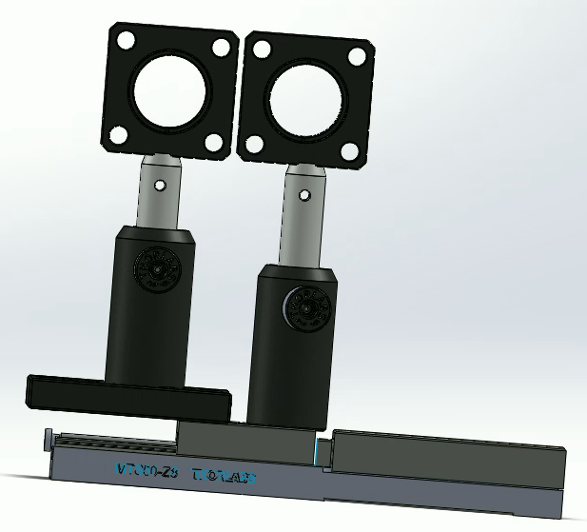
Proposed Mounting Scheme
Draft solidworks model (mates are not completed)
Translation

Slide 22
06/25/2022
First Demonstration of Full Mueller Polarimetry!

Slide 23
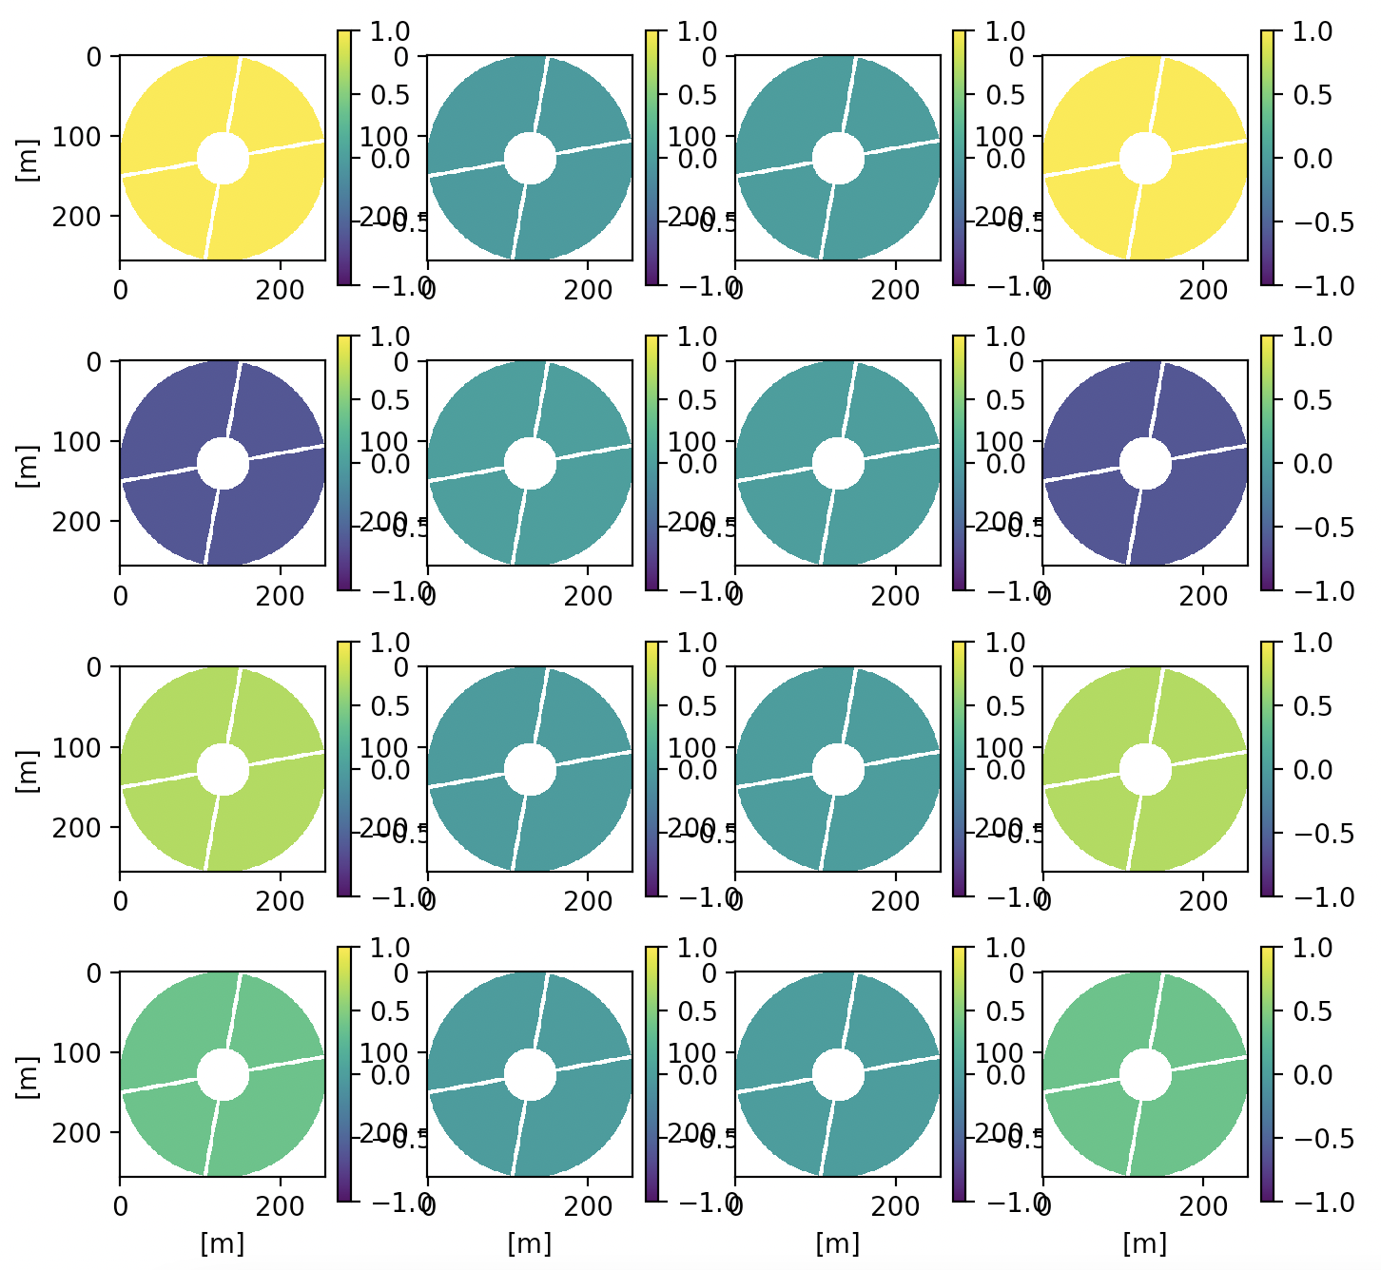
Subaru-like pupil
Applied Photon Noise
Percent Error is ~10⁻¹⁰
Basically it works ^{in simulation…}
Two fixed polarizers, two rotating quarter waveplates

Slide 24


Measurement Redundancy
Result is not dependent on particular analyzer orientation
The polarizing beam splitter acts like our analyzer and we get two channels!
Detector
$$I_{Q+}$$
Detector
$$I_{Q−}$$
From VAMPIRES

Slide 25
Plans at Summit?
Julien? Sebastiaan?
Install 2 lenses to get pupil on SCExAO
Move electronics rack
Minimum goal
PDI on two PSFs with calibration source
Does the pupil phase have a polarization dependence?
PDI on two pupil images
Does the pupil amplitude have a polarization dependence?

Slide 26
Polarimeter Algorithm

Slide 27
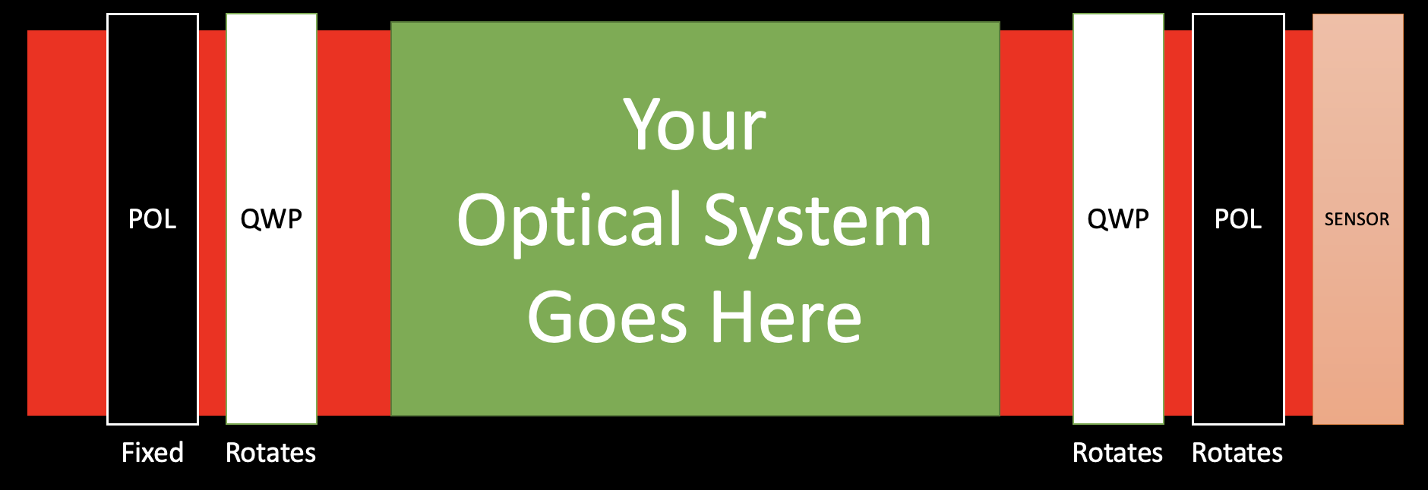


Goal: Measure a System Mueller Matrix
Rotates at frequency $ω$
Rotates at frequency $5ω$

Slide 28




Polarimeter Algorithm
Step retarders
Compute generator vector $\vec{g}$
Compute analyzer vector $\vec{a}$
Compute polarimetric data reduction matrix
Measure the power on a pixel
Compute Mueller Matrix
$$\overline{W}=\vec{a} X \vec{g}$$
$$P=\vec{a} \overline{M} \vec{g}$$
$$\overline{M}={\overline{W}}^{−1}\overline{P}$$

Slide 29
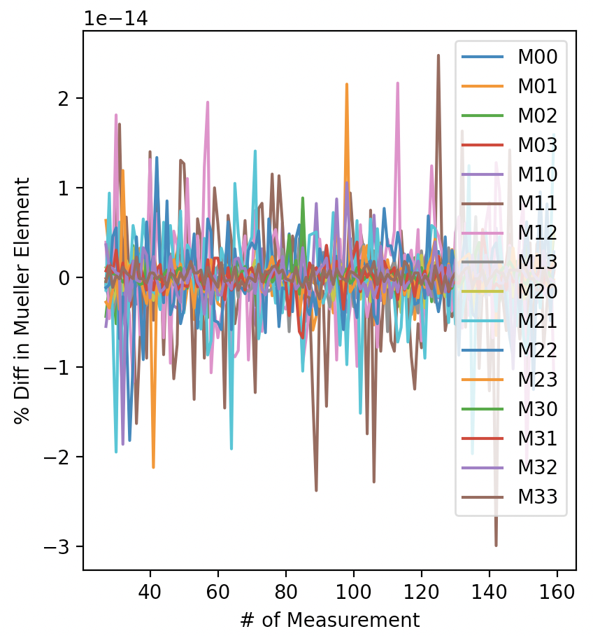
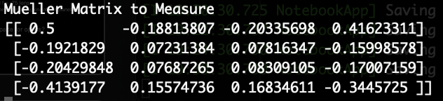
Algorithm Test
How good is the algorithm?
Random Mueller Matrix
Step through # of retarder steps to determine how well values are recovered
After ~27 steps, it really doesn’t matter

Slide 30
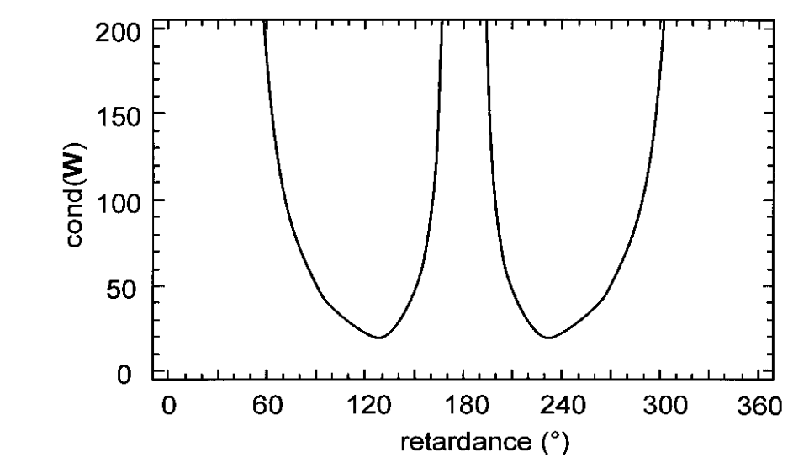
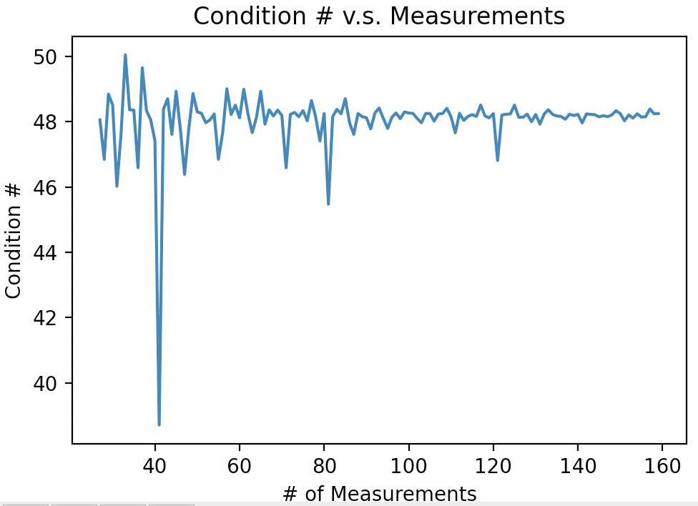
Compare to Literature
Condition Number – how singular is the measurement?
QWP ~50
Condition number v.s. retardance used for rotating retarders. Smith 2002
Matches the literature expected condition number value! Algorithm is working correctly.

Slide 31

Real Optics are Always Worse
The Condition Number tells us what is ideal
Nonuniformities in the polarization optics make this worse
Prefer going to $λ/3$ retarders!
Condition Number tells us how good the measurement is
Can further reduce uncertainty using two channels!

Slide 32
Extra Slides

Slide 33
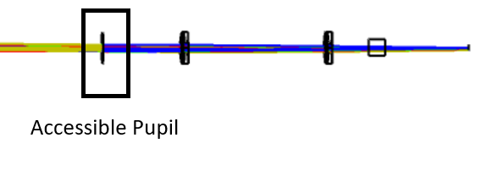
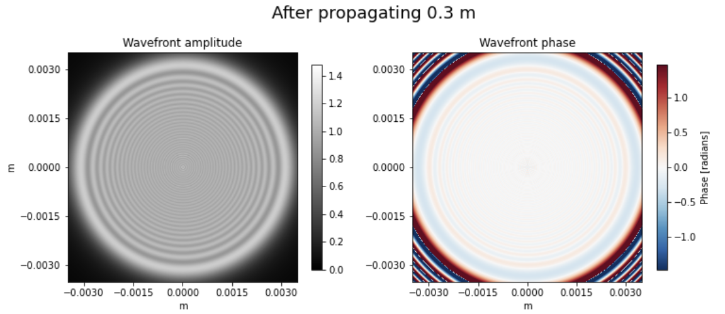
The SCExAO Camera
Some options to relay the pupil to the image plane
Keplerian Relay (two positive lenses)
Replace camera lenses with afocal lenses
More complicated, more optical path needed
Galilean Relay (a positive and negative lens)
Place negative lens before/after pupil
Must be very close to the pupil
Remove Camera
Get Fresnel diffraction effects from propagation
The telephoto lens

Slide 34
Things to Know
Do we know what lenses are in this path?
The Solidworks model says a f = 150 and f = -50 lens
Norris et al 2015 says a f = 200 and f = -75 lens
The VAMPIRES instrument: Imaging the innermost regions of protoplanetary disks with polarimetric interferometry
Where might there be available space for optics?

Slide 35
Full Stokes Polarimetry
Goal: Measure the Stokes vector of the light incident on the polarization state analyzer (PSA)
Optical System
PSA

Slide 36
Full Mueller Polarimetry
Goal: Measure the Mueller matrix of an optical system between a Polarization State Generator (PSG) and PSA
I believe VAMPIRES has a PSG?
Optical System
PSG
PSA

Slide 37
Rotation Stages
https://www.newport.com/p/AG-PR100
https://www.thorlabs.com/thorproduct.cfm?partnumber=K10CR1

